Slide 1

Market Risk Analysis
Project Report - Part B
By: Mustafa Assem Mubarak, MDS- December 2023
.
Proprietary content. © Great Learning. All Rights Reserved. Unauthorized use or distribution prohibited.

Slide 2
Table of Content
Data Overview
Problem Statement
Approach
Exploratory Data Analysis (EDA)
Average Returns and Fluctuations - Plots e
Average Returns and Fluctuations – Overview
Insights & Recommendations

Slide 3
1 - Data Overview
Total Stocks
Time Frame
High Stock - Price
High Stock – S.D
10
Six Year
Shree_Cement
Shree_Cement
Last Ǫtr Revenue
Analysis Overview
High Return - Stock
High Risk - Stock
Lowest Return
Lowest Risk
Shree_Cement
Idea_Vodafone
Idea_Vodafone
Infosys

Slide 4
2 - Problem Statement
Summary:
Given a dataset containing 6 years of weekly stock information for 10 Indian companies, this project aims to analyze and quantify the market risk associated with these investments. By calculating the mean return and standard deviation of each stock, we can identify potential investment opportunities and assess the inherent risks involved in building a portfolio with these stocks. By using Python for data analysis and visualization, we will gain valuable insights into the risk-return relationship of these Indian stocks, ultimately aiding in informed investment decisions.

Slide 5
3 - Approach
Approach:
To understand the risks involved in these Indian stocks, we looked at their returns over 6 years. by:
1 - Weekly Change as a Special Percentage: Stock prices don't always change by the same amount, so, to make it easier, we used logarithms. This helps compare stocks with different starting prices more accurately.
2 - Average Returns and Fluctuations: We then looked at two key measures:
Average Weekly Return: This tells us how much money a stock, on average, makes each week (as a percentage).
Volatility (how much the price moves): We calculated the standard deviation, which shows how much the weekly returns varied from the average. A high standard deviation means the stock's price tends to swing up and down (Risky)
By analyzing these average returns and volatility, we can get a good idea of how risky each stock might be as an investment.

Slide 6
4 - Exploratory Data Analysis (EDA)

Slide 7
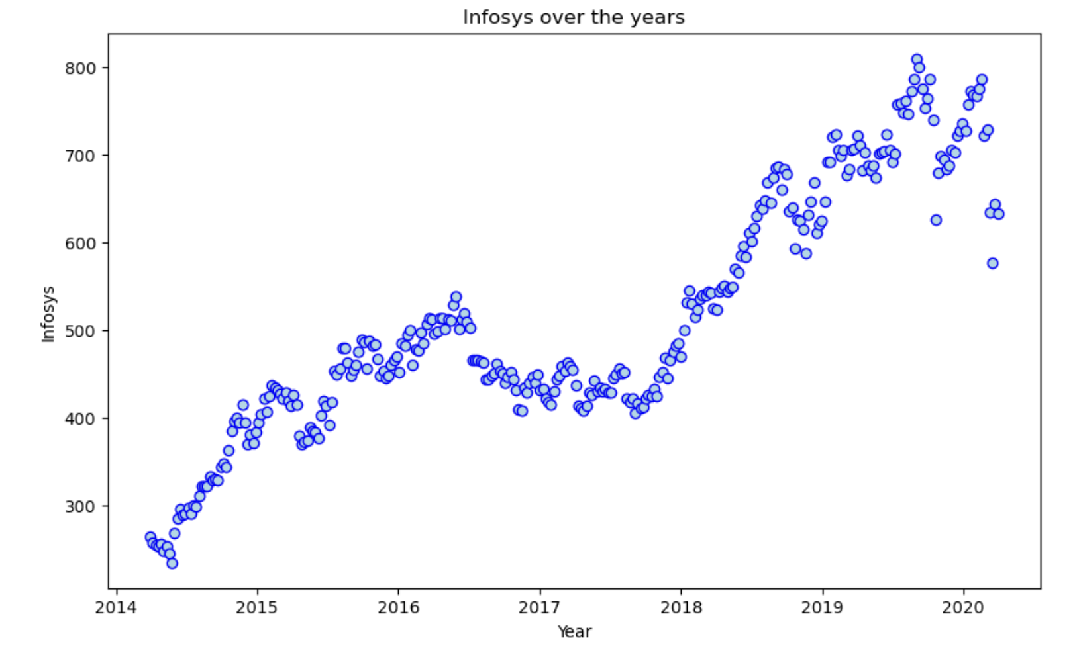
Infosys - Stock
Observations / Findings
Infosys stock prices generally increased over time.
However, there was a price decrease in 2020Data capturing some peaks and troughs
The price fluctuated between 300 and 800 during the observed period.
Prices saw a significant increase starting from 2018

Slide 8
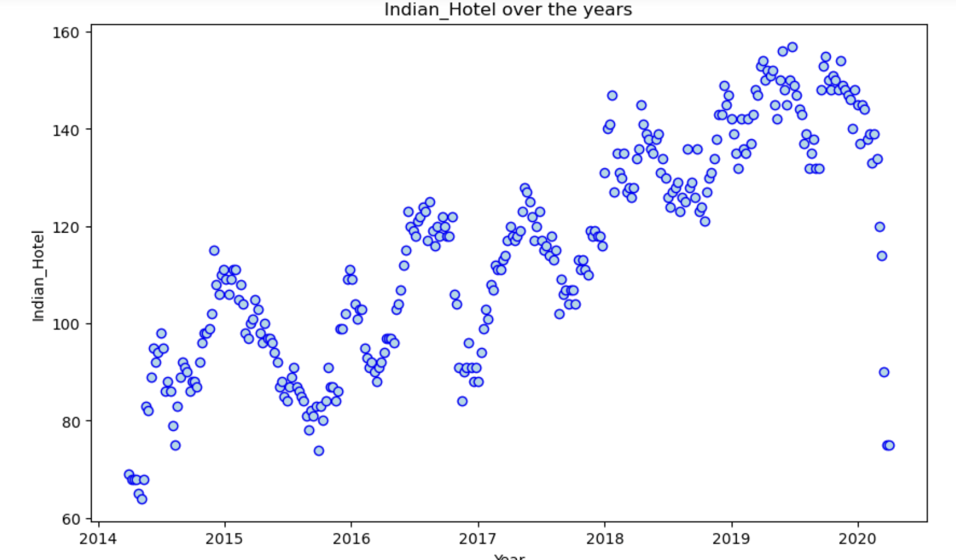
Indian Hotel - Stock
Observations / Findings
Indian Hotel stock prices generally increased over time.
However, there was a significant price decrease in 2020
Data capturing some pattern of seasonality
The price fluctuated between 60 and 160 during the observed period.

Slide 9
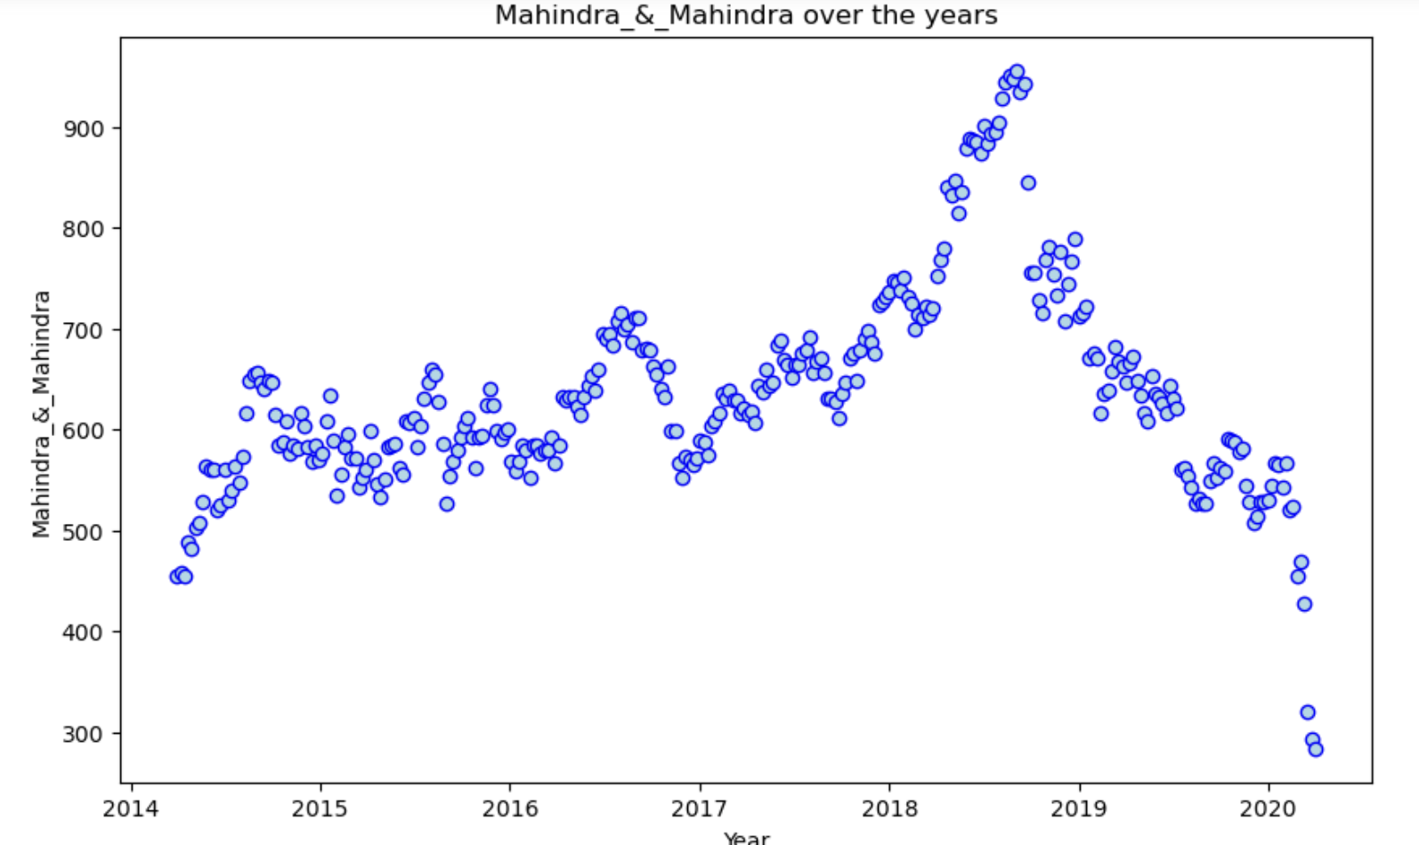
Mahindra & Mahindra - Stock
Observations / Findings
Mahindra stock prices generally increased over time and have decreased from year 2019
However, there was a significant price decrease in 2019
Data capturing some pattern of seasonality
The price fluctuated between 450 and 900 during the observed period.
.

Slide 10
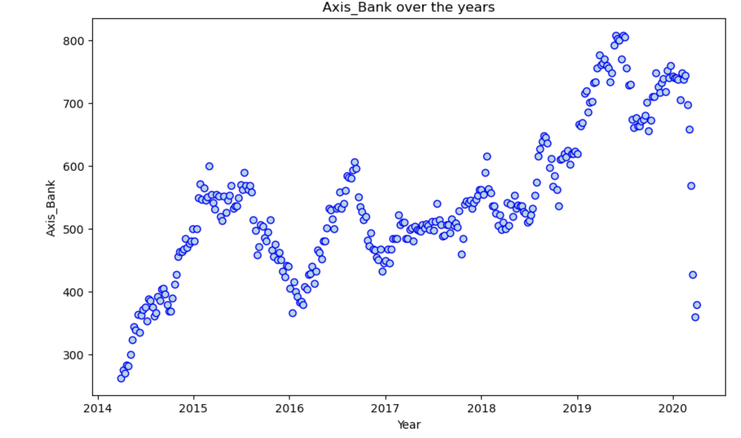
Axis Bank - Stock
Observations / Findings
Axis bank stock prices generally increased over time.
However, there was a price decrease in 2020, Data capturing some peaks and troughs
The price fluctuated between 300 and 800 during the observed period.
Prices saw a significant increase starting from 2017

Slide 11
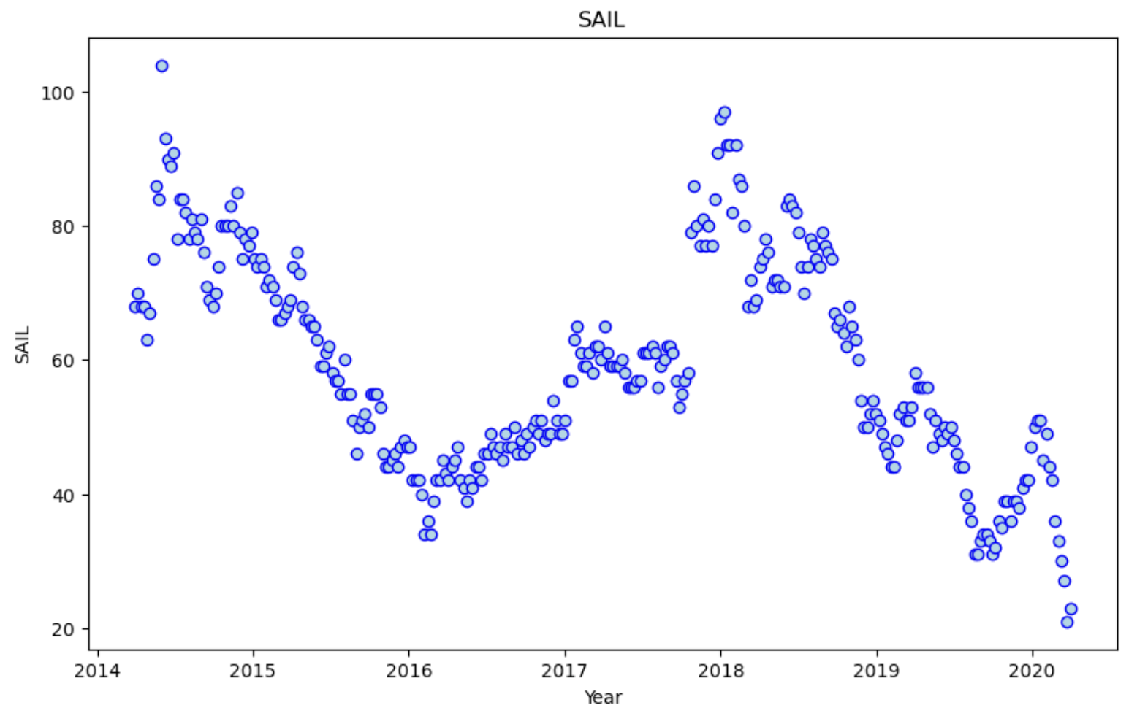
SAIL – Stock - Stock
Observations / Findings
SAIL stock prices generally decreased over time.
However, there was a price increase in 2016, data capturing some peaks and troughs
The price fluctuated between 20 and 100 during the observed period.
Prices saw a significant decrease starting from 2018

Slide 12
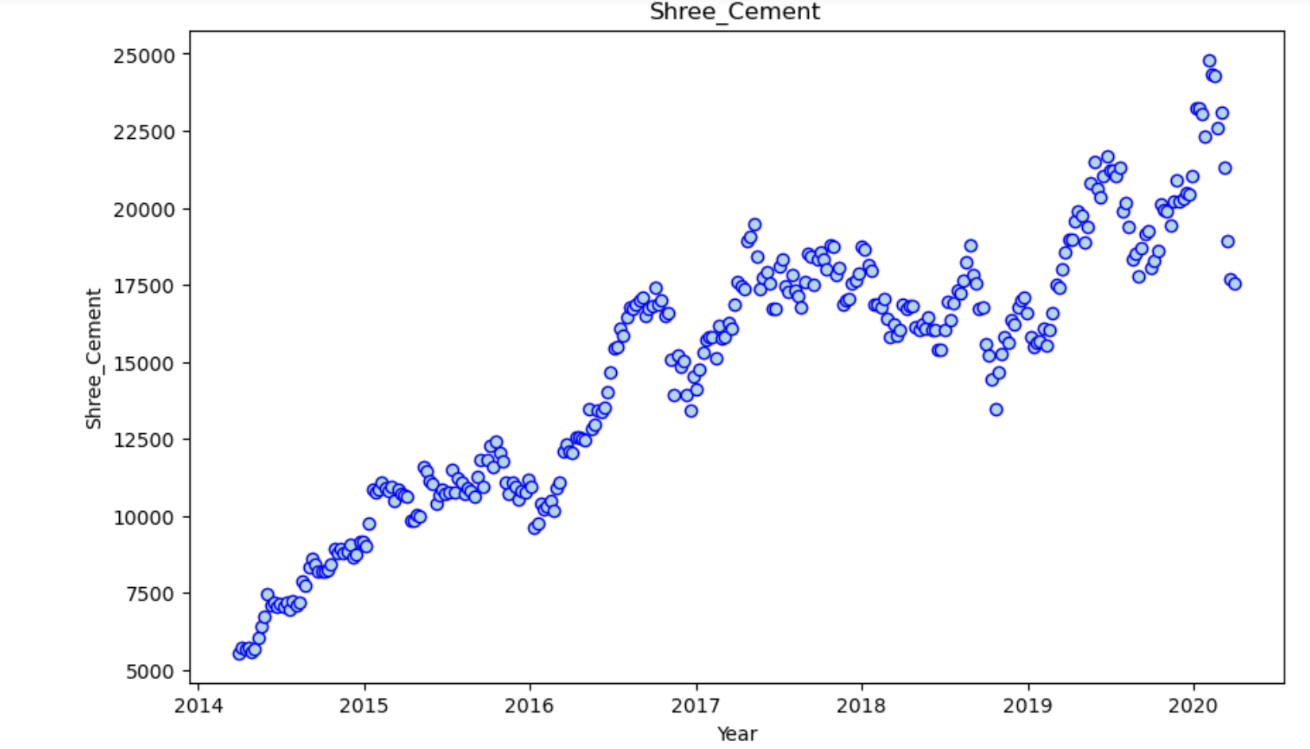
Shree Cement - Stock
Observations / Findings
Shree stock prices generally increased over time.
However, there was a price decrease in 2019/ 2020, data capturing some peaks and troughs
The price fluctuated between 5000 and 25000 during the observed period.
Prices saw a significant increase starting from 2016

Slide 13
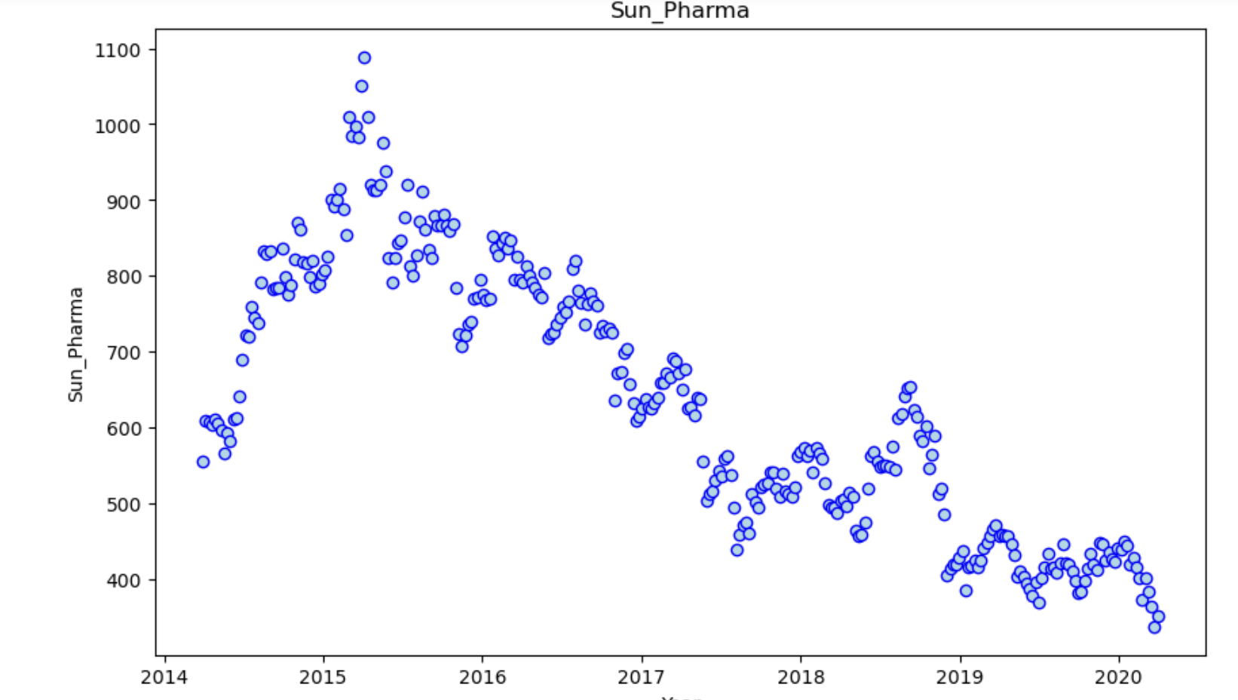
Sun Pharma - Stock
Observations / Findings
Sun Pharma stock prices generally decreased over time.
However, there was a price increase in 2018, data capturing some peaks and troughs
The price fluctuated between 550 and 1100 during the observed period.
Prices saw a significant decrease starting from 2015

Slide 14
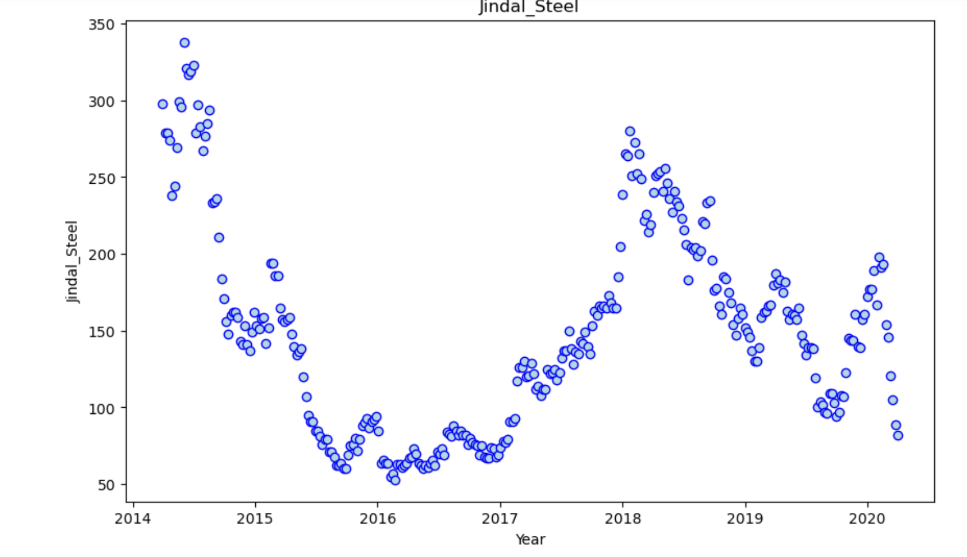
Jindal Street - Stock
Observations / Findings
Jindal Street stock prices generally decreased over time.
However, there was a price increase in 2018, data capturing some peaks and troughs
The price fluctuated between 60 and 350 during the observed period.
Prices saw a significant decrease starting from 2014

Slide 15
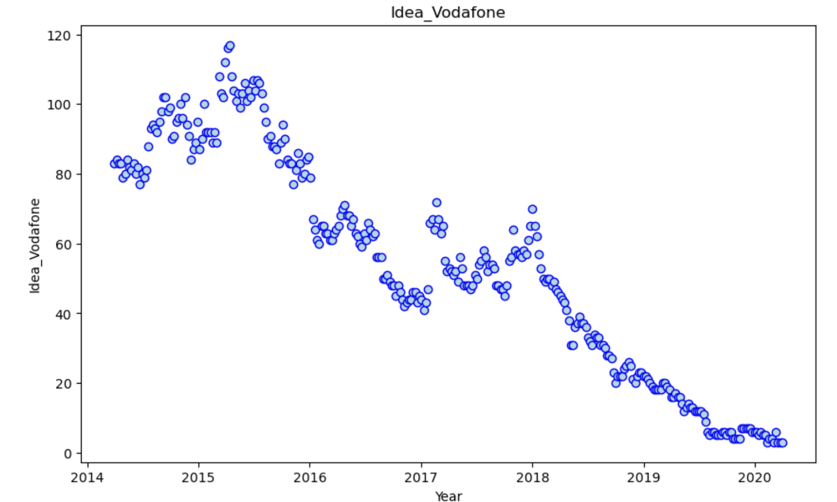
Idea Vodafone - Stock
Observations / Findings
Idea Vodafone stock prices generally decreased over time.
However, there was a price increase in 2018, data capturing some peaks and troughs
The price fluctuated between 1 and 120 during the observed period.
Prices saw a significant decrease starting from 2018 end.

Slide 16
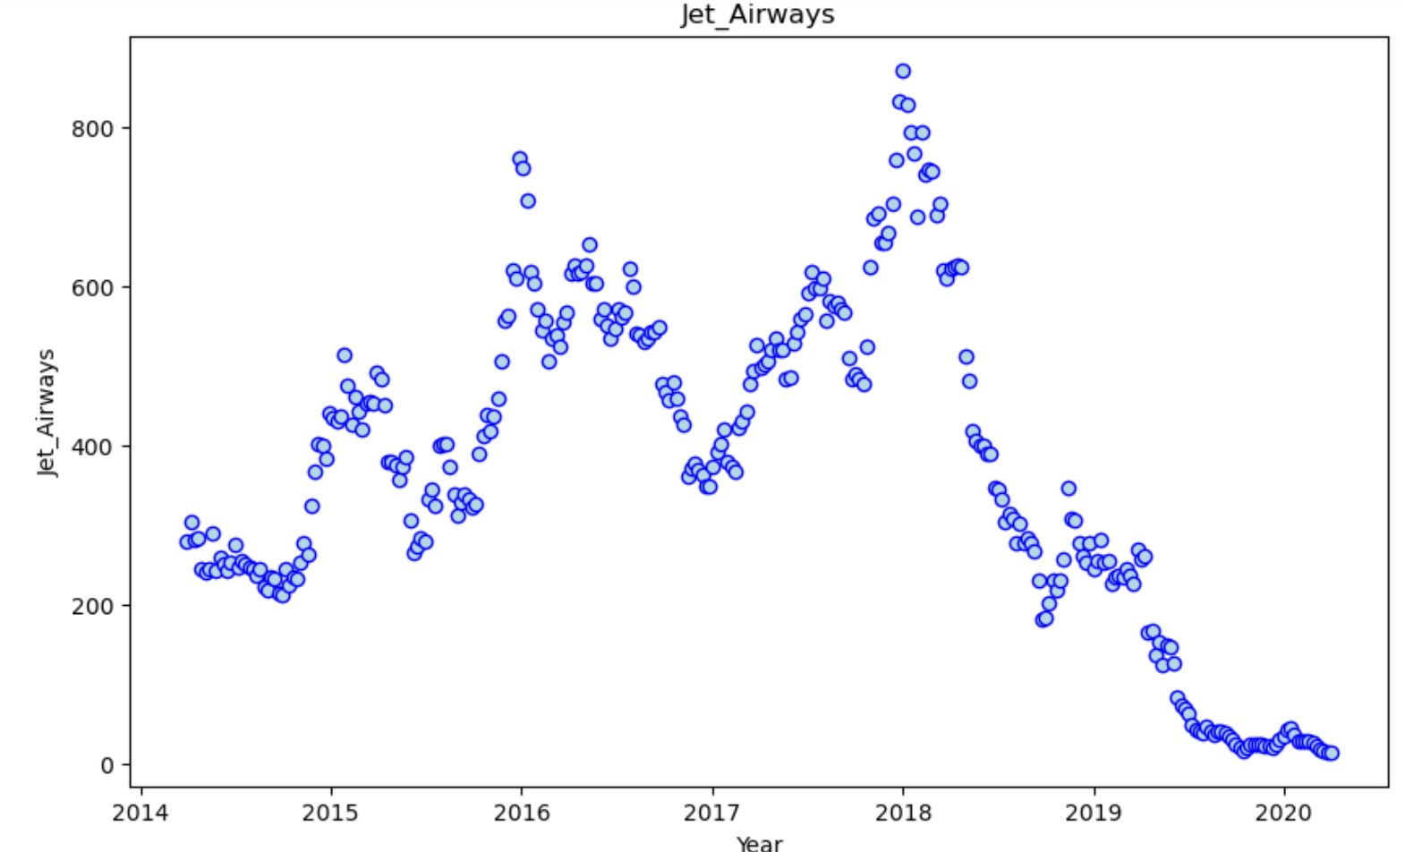
Jet Airways - Stock
Observations / Findings
Jet Airway stock prices generally decreased over time.
However, there was a price increase in 2018, data capturing some peaks and troughs
The price fluctuated between 20 and 850 during the observed period.
Prices saw a significant decrease starting from 2018 end.
..

Slide 17
Average Returns and Fluctuations

Slide 18
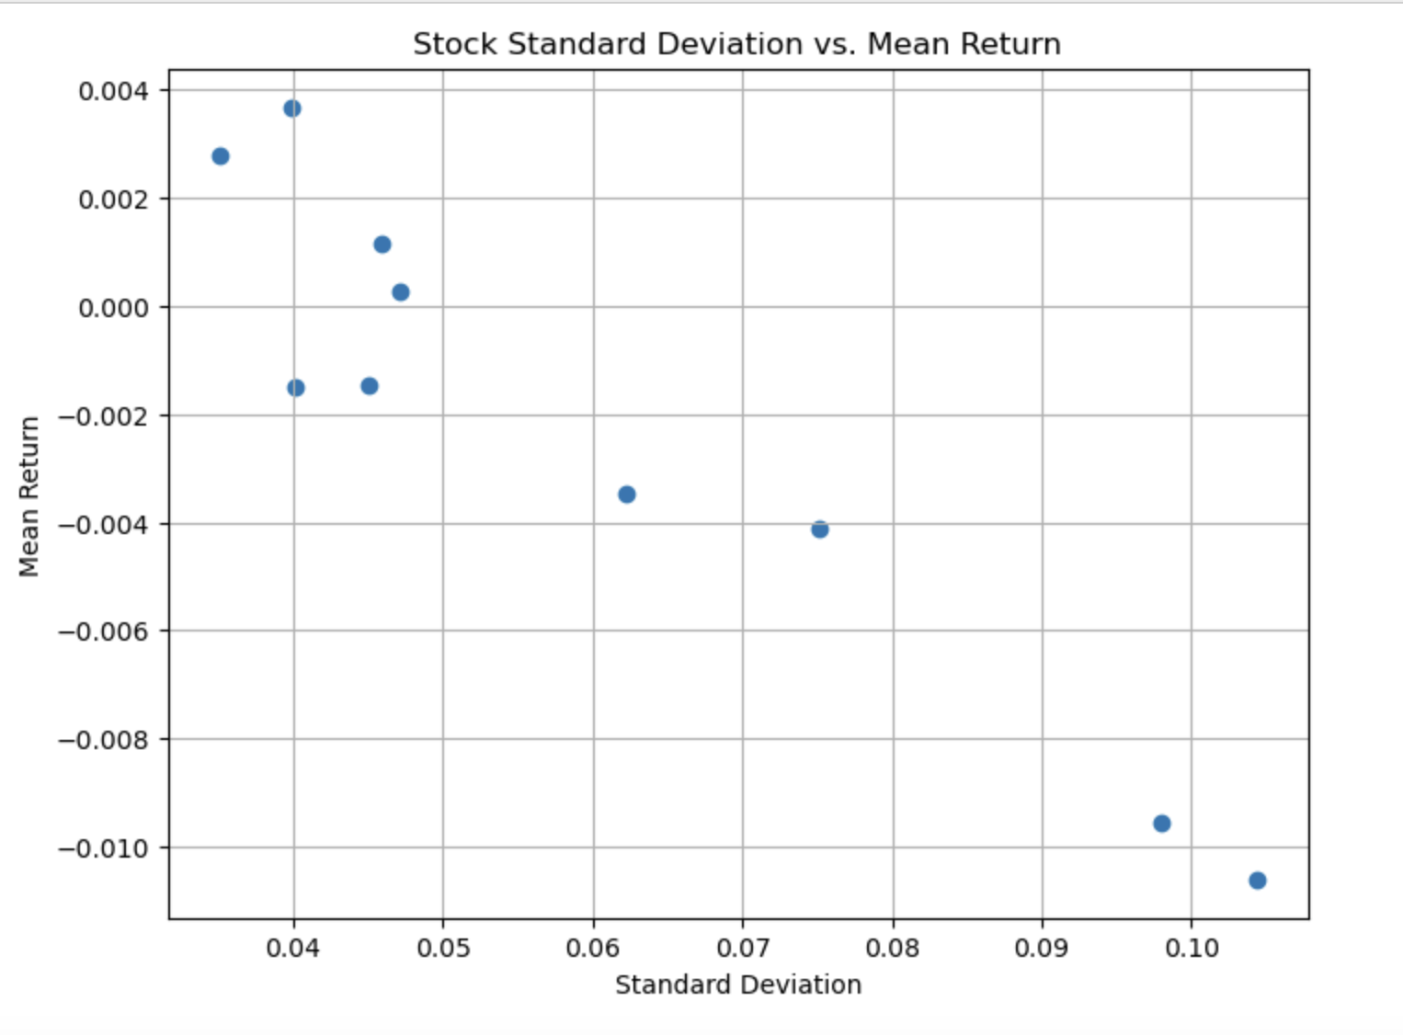
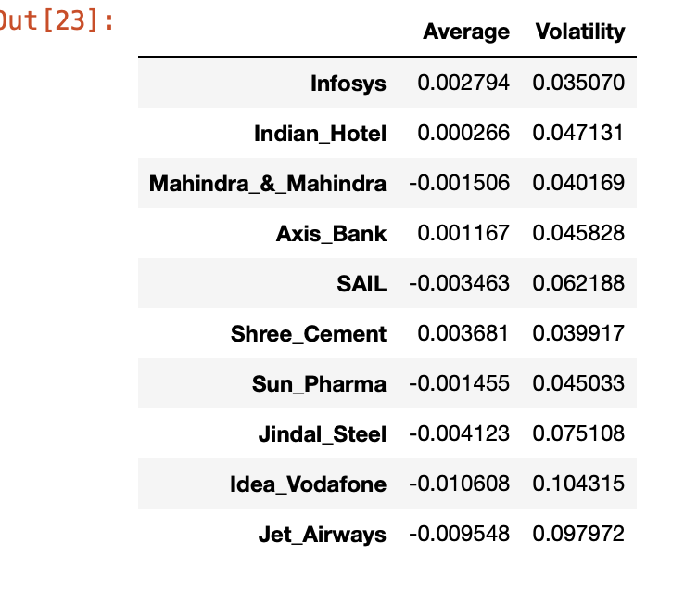
5 - Average Returns and Fluctuations - Plots

Slide 19
6 - Average Returns and Fluctuations - Overview
Insights about chosen Stocks – Fluctuations and Return:
Infosys (Low Volatility, High Return): Infosys exhibits relatively low volatility (0.002794) and a high average return (0.035070). This suggests potentially good returns with lower risk compared to some other stocks.
Indian Hotel (Low Volatility, Moderate Return): Indian Hotel has low volatility (0.000266) but a moderately lower average return (0.047131) compared to Infosys. While less volatile, it might offer slightly lower potential gains.
Mahindra & Mahindra (Moderate Volatility, Moderate Return): Mahindra & Mahindra shows moderate volatility (0.001506) and a moderate average return (0.040169). This indicates a balance between risk and potential reward.
Axis Bank (Moderate Volatility, Moderate Return): Similar to Mahindra & Mahindra, Axis Bank exhibits moderate volatility (0.001167) and a moderate average return (0.045828).

Slide 20
7 - Insights and Recommendations
The scatter plot of “Average Returns and Fluctuations” of all stocks mentioned earlier suggested a positive correlation between standard deviation (volatility) and mean return (average return). While this trend is generally evident in stocks such as (Infosys & Axis Bank), I see some deviations exist such as (Indian Hotel). This might need more comprehensive analysis that considers other financial metrics.
I believe there is a significant impact of external events like the 2020 pandemic on stock prices. The market were down in 2020 likely skewed the mean return and standard deviation calculations for many stocks. That is may mess up our calculation for future predication.
I suggest to enhance analysis robustness, consider dropping data from 2020 (if that possible) and extending the time frame to more than 6 years. This can provide a more representative picture of historical performance.
Also, there are a significant price movements in 2018 for many stocks might be influenced by external factors beyond individual company performance. Further investigation in these external factors could provide valuable insights.
As this analysis offered not bad insights, however, there is a limitations of the dataset. Including a benchmark index (like the Sensex) could provide a valuable reference point for evaluating the relative performance of the analyzed stocks.

Slide 21
—
—
END

